Slide 1
Creative News Media Word cloud generator
Huiming Sun
Hao Ding
Huang Rui
Yunzhi Tang
Yiqing Wang

Slide 2

What is a Word cloud?
Word cloud is a visual representation of text data, typically used to depict keyword metadata on websites, or to visualize free form text. Tags are usually single words, and the importance of each tag is shown with font size or color.

Slide 3
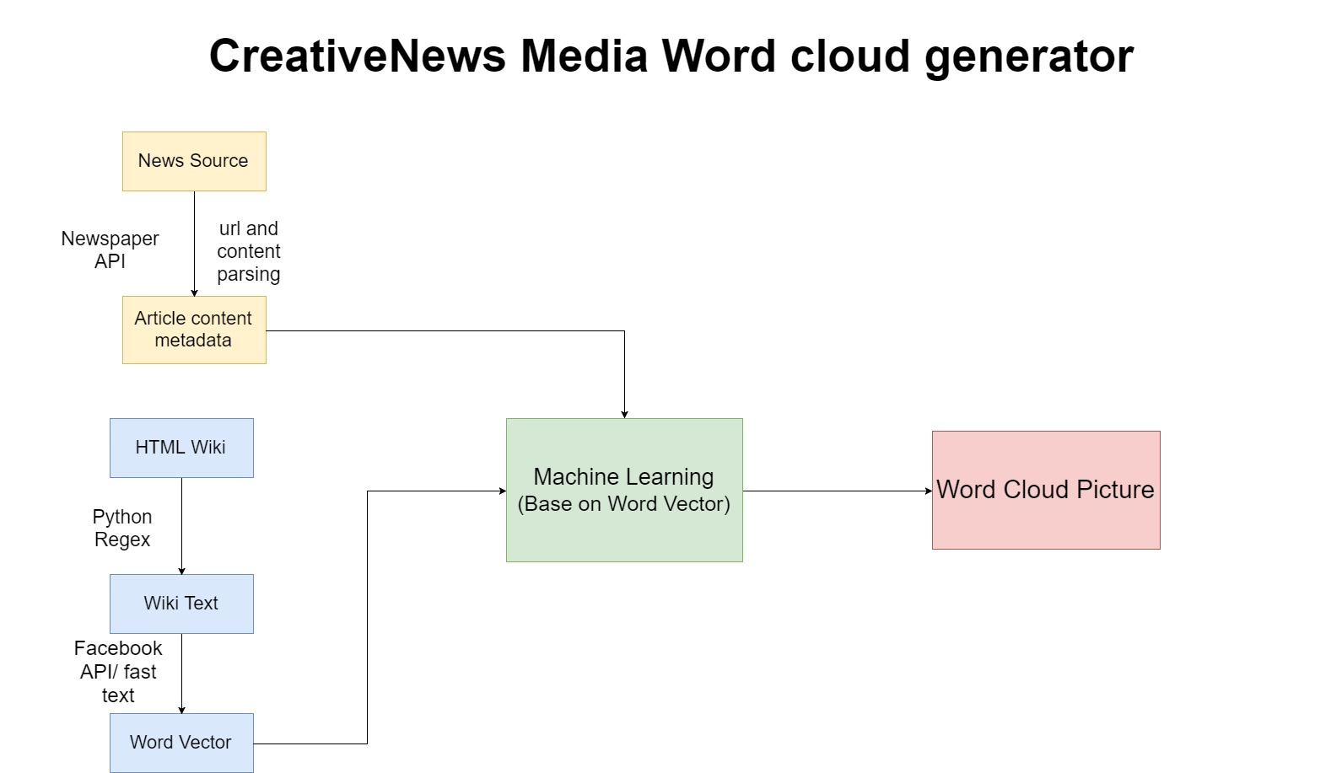

Slide 4

Up-to-date News content extraction
We write a python script that can obtain the most up-to-date news articles’ urls from a lot of mainstream news media (eg. USA today, KY3 News, BBC News) and by accessing collected urls one by one, fetch contents from each article to separate text file

Slide 5

Word Cloud, Word Vector, Word Frequency Algorithm
To test and optimize different algorithms outcome, we set up 3 different ways in the process of generating word cloud pictures.
In each scenario, we applied word cloud, word vector and word frequency algorithm accordingly

Slide 6
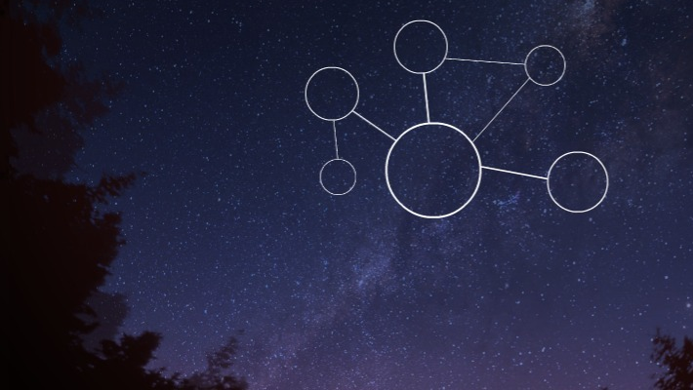
Stop Words
In computing, stop words are words which are filtered out before or after processing of natural language data (text)
Word Vector
Word2vec is a group of related models that are used to produce word embeddings. These models are shallow, two-layer neural networks that are trained to reconstruct linguistic contexts of words. Word2vec takes as its input a large corpus of text and produces a vector space, typically of several hundred dimensions, with each unique word in the corpus being assigned a corresponding vector in the space. Word vectors are positioned in the vector space such that words that share common contexts in the corpus are located in close proximity to one another in the space.
Word Frequency
The word frequency utilizes word count and is greatly relate to the number of words in a document or passage of text.

Slide 7

Technology Stack:
Newspaper package
(https://github.com/codelucas/newspaper)
Facebook API
(https://github.com/facebookresearch/fastText)
Word Cloud package
(https://github.com/amueller/word_cloud)

Slide 8


Slide 9
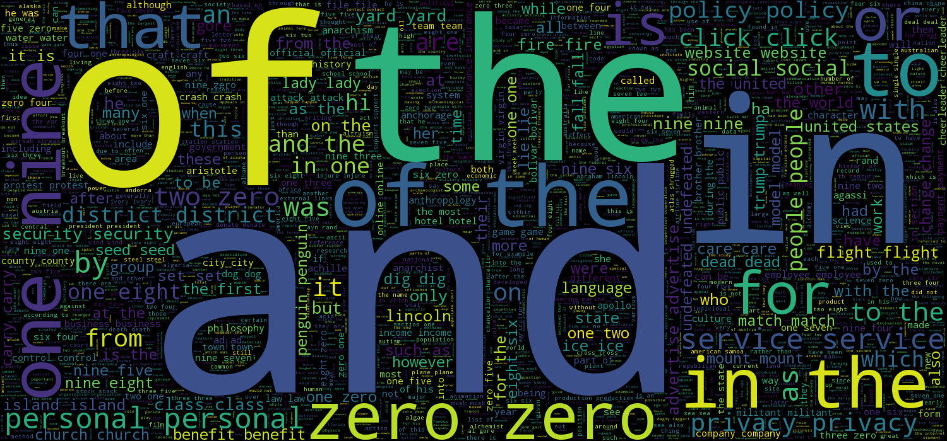

Slide 10
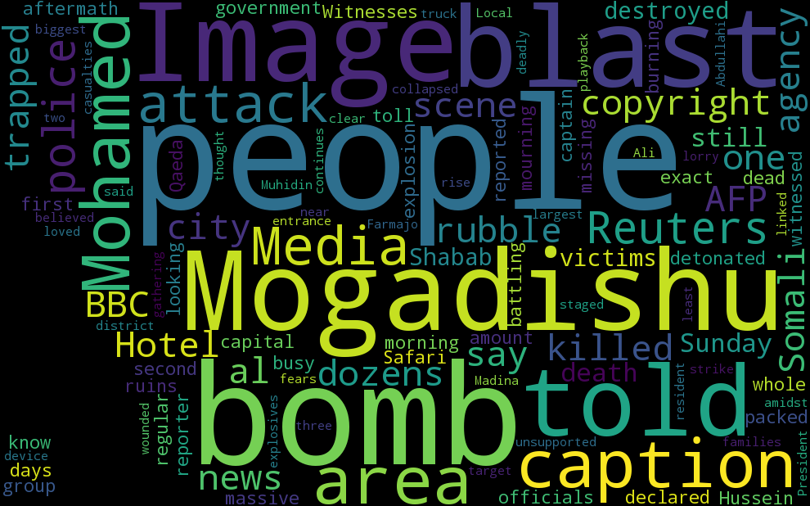

Slide 11
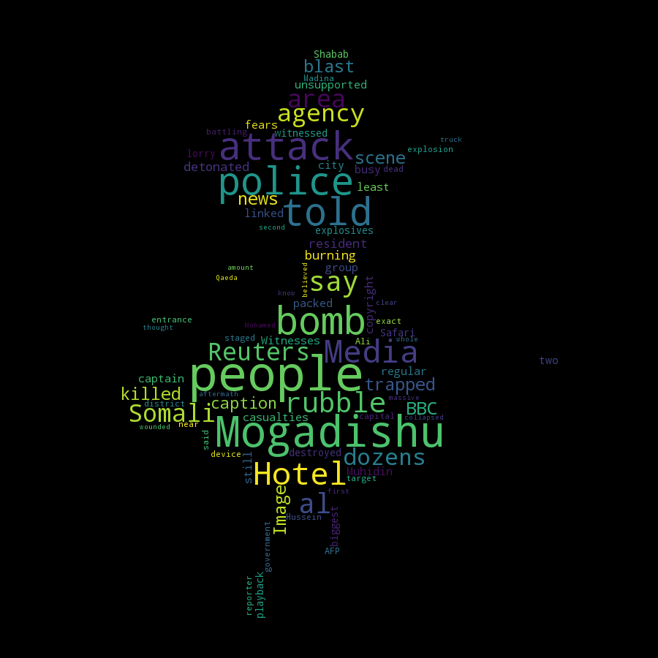

Slide 12
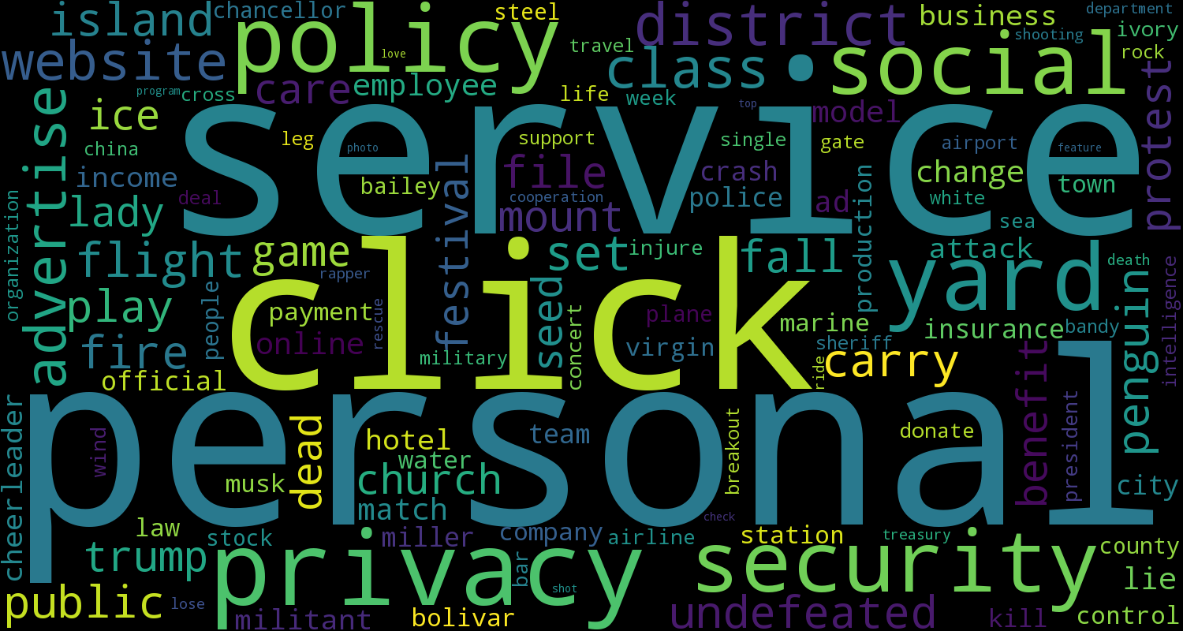

Slide 13
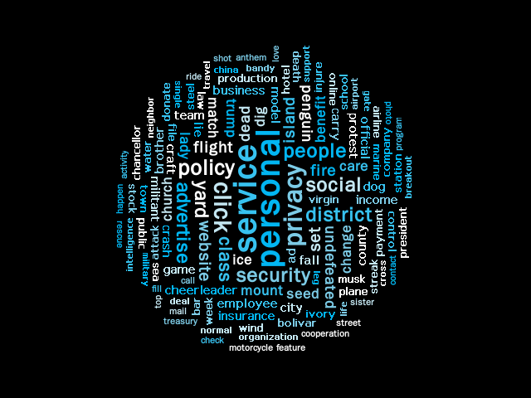

Slide 14
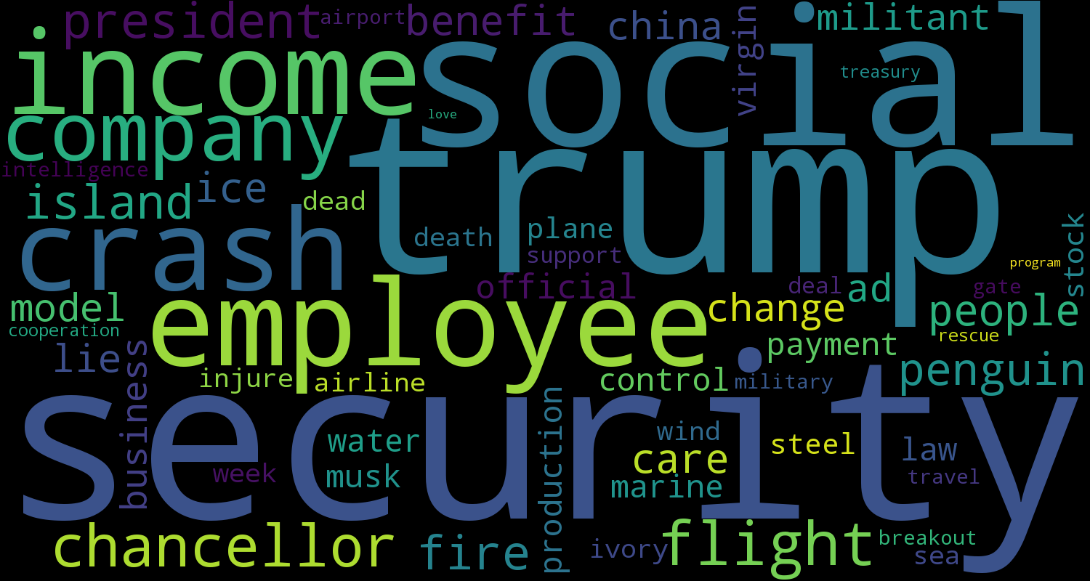

Slide 15
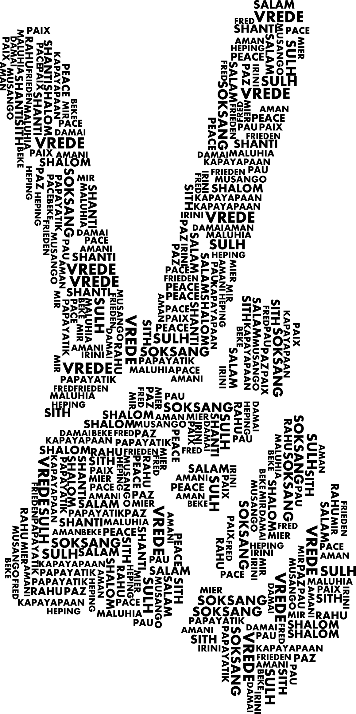
This is the end! Thank you!

